Slide 1


Slide 2
Building Ansible Modules Workshop

Slide 3
Agenda
10:00 – 10:30 Welcome
10:30 – 11:00 architectural overview
11:00 – 12:00 Creating your 1st Module
12:00 – 12:30 Idempotency
12:30 – 13:30 Lunch
13:30 – 14:00 Checkmode
14:00 – 14:30 Documentation
14:30 – 15:30 Testing the module
15:30 – 16:00 Submitting the module to Ansible
16:00 – 17:00 Drinks

Slide 4
Content
Who am I to tell you how to write modules?
Should you write a module?
Ansible module Architecture
Interaction between the module and ansible
Interaction between the module and external commands
Where to put the module
Writing a small module
Idempotency
Extending the module with parameters
Adding Checkmode
Documenting the module
Testing the module
Contributing your module to Ansible
https://github.com/molekuul/modules_workshop

Slide 5
Who am I
Joris Weijters
21 years in IT
11 years at SLTN/Interaccess
2 years Ansible experience
All kinds of opensource experience, but also an AIX engineer
I’m not a Python programmer
I wrote several modules and added one to ansible
WIFI: IA-guest ??

Slide 6
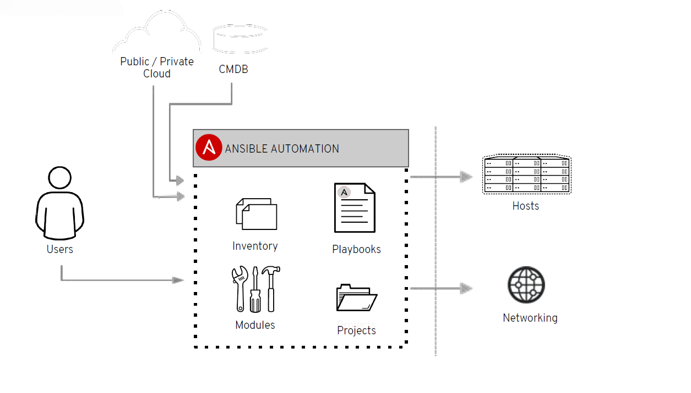
What are Modules
Notes:
With Ansible 2.7 almost 2350 modules are shipped

Slide 7
What are Modules
Playbooks
● Written in YAML
● Tasks are executed in sequence
● Tasks call on Ansible modules
Notes:
With Ansible 2.7 almost 2350 modules are shipped

Slide 8
What are Modules
Modules are “tools in the the
toolkit”
● Python, Powershell or any
language
● Extend Ansible simplicity to
entire stack
Notes:
With Ansible 2.7 almost 2350 modules are shipped

Slide 9
Should you develop a module
Does a similar module exist?
http://docs.ansible.com/ansible/latest/modules/modules_by_category.html
Has someone already worked on a similar Pull request?
https://github.com/ansible/ansible/labels/new_module
https://github.com/ansible/ansible/labels/module
https://ansible.sivel.net/pr/byfile.html
Should you use or develop an action plugin?
https://docs.ansible.com/ansible/latest/dev_guide/developing_plugins.html#developing-plugins
Should you use a Role?
https://docs.ansible.com/ansible/latest/user_guide/playbooks_reuse_roles.html#playbooks-reuse-roles
Should you write multiple modules?
complexity kills productivity
Notes:
Before diving into the work of creating a new module, you should think about whether you actually should develop a module. Ask the following questions:
Does a similar module already exist?
There are a lot of existing modules available, you should check out the list of existing modules at Importing Modules
Has someone already worked on a similar Pull Request?
It’s possible that someone has already started developing a similar PR. There are a few ways to find open module Pull Requests:
GitHub new module PRs
All updates to modules
New module PRs listed by directory search for lib/ansible/modules/
If you find an existing PR that looks like it addresses the issue you are trying to solve, please provide feedback on the PR - this will speed up getting the PR merged.
Should you use or develop an action plugin instead?
Action plugins get run on the master instead of on the target. For modules like file/copy/template, some of the work needs to be done on the master before the module executes on the target. Action plugins execute first on the master and can then execute the normal module on the target if necessary.
For more information about action plugins, read the action plugins documentation.
Should you use a role instead?
Check out the roles documentation.
Should you write multiple modules instead of one module?
The following guidelines will help you determine if your module attempts to do too much, and should likely be broken into several smaller modules.
Modules should have a concise and well defined functionality. Basically, follow the UNIX philosophy of doing one thing well.
Modules should not require that a user know all the underlying options of an api/tool to be used. For instance, if the legal values for a required module parameter cannot be documented, that’s a sign that the module would be rejected.
Modules should typically encompass much of the logic for interacting with a resource. A lightweight wrapper around an API that does not contain much logic would likely cause users to offload too much logic into a playbook, and for this reason the module would be rejected. Instead try creating multiple modules for interacting with smaller individual pieces of the API.

Slide 10
So What should the Module do?
Know what you want to do with the module.
Modules should have a concise and well defined functionality.
Modules should not require that a user know all the underlying options of an API/tool to be used.
Modules should typically contain much of the logic for interacting with a resource.
Which commands are necessary?
Make it abstract
In this workshop:
Create a file
Remove a file
We use the commands:
touch: to create a file
rm: to remove a file
Notes:
Basically, follow the UNIX philosophy of doing one thing well.
For instance, if the legal values for a required module parameter cannot be documented, that’s a sign that the module would be rejected
A lightweight wrapper around an API that does not contain much logic would likely cause users to offload too much logic into a playbook, and for this reason the module would be rejected. Instead try creating
multiple modules for interacting with smaller individual pieces of the API

Slide 11
Ansible Module Architecture
Types of Modules
Action Plugins
New-style Modules
Python
Ansiballz framework
Powershell
Module Replacer
Non-native WANT_JSON Modules
Binary Modules
https://docs.ansible.com/ansible/latest/dev_guide/developing_program_flow_modules.html
Notes:
Action Plugins look like modules to end users who are writing playbooks but they’re distinct entities for the purposes of this document. Action Plugins always execute on the controller and are sometimes able to do all work there (for instance, the debug Action Plugin which prints some text for the user to see or the assert Action Plugin which can test whether several values in a playbook satisfy certain criteria.)
More often, Action Plugins set up some values on the controller, then invoke an actual module on the managed node that does something with these values. An easy to understand version of this is the template Action Plugin. The template Action Plugin takes values from the user to construct a file in a temporary location on the controller using variables from the playbook environment. It then transfers the temporary file to a temporary file on the remote system. After that, it invokes the copy module which operates on the remote system to move the file into its final location, sets file permissions, and so on.
Python modules with the Ansiballz Framework is wat we are going to work on today
Next to this you can have modules written in Powershell, they use the Module Replacer framework
None-native WANT_JSON Modules: Contain the WANT_JSON string. They can only accept 1 parameter: filename wich contains the JSON parameters
Binary Modules: Ansible doesn’t perform any magic to make these portable to different systems so they may be specific to the system on which they were compiled or require other binary runtime dependencies. Despite these drawbacks, a site may sometimes have no choice but to compile a custom module against a specific binary library if that’s the only way they have to get access to certain resources.
Binary modules take their arguments and will return data to Ansible in the same way as want JSON modules.

Slide 12
Ansiballz Framework
Uses Python import of ansible/module_utils
from ansible.module_utils.basic import AnsibleModule
Passing arguments with argument_spec and params
Communicates back to ansible with exit_json and fail_json
Communicates to the shell with get_bin_path and run_command

Slide 13
Arguments_spec and params
module = AnsibleModule(
argument_spec=dict(
argument1=dict(type='str',
default='default', required=True)
argument2=dict(type=string,
choices=['absent', 'present'],
default='present')
)
)
argument1 = AnsibleModule.params['argument1']
https://docs.ansible.com/ansible/latest/dev_guide/developing_program_flow_modules.html#argument-spec
Notes:
The argument_spec provided to AnsibleModule defines the supported arguments for a module, as well as their type, defaults and more.
Argument: type
type allows you to define the type of the value accepted for the argument. The default value for type is str. Possible values are:
str, list, dict, bool, int, float, path, raw, jsonarg, json, bytes, bits
Argument: default
Defines default value
Argument: choices
Accepts a list of choices the
Argument required:

Slide 14
exit_json and fail_json
result = { msg: "message",
changed: False
}
AnsibleModule.exit_json(**result)
AnsibleModule.fail_json(msg="message", rc=rc, err=err)

Slide 15
get_bin_path and run_command
Use get_bin_path to find a executable in PATH
Command = AnsibleModule.get_bin_path(rm)
run_command(args)
This executes a command
args is a string or a list
Returns: rc, stdout, stderr
rc, out, err = AnsibleModule.run_command(command)

Slide 16
Where to put the module
When installed as a package
/usr/lib/python2.7/site-packages/ansible/modules/
Cloned from github
ansible/lib/ansible/modules
/etc/ansible/ansible.cfg
#library = /usr/share/my_modules/

Slide 17
Where to put the module
Add the module to your playbook directory
.
├── library
│ └── my_module.py
└── site.yml

Slide 18
Where to put the module
Create a role with your module
.
├── roles
│ └── modules_role
│ └── library
│ └── my_module.py
└── site.yml

Slide 19
First version of your module
We start to experiment writing the module
And writing a playbook to use the module for adding and removing the file
Start with the definition of the arguments
Handle the arguments
Program the actions
Create feedback to ansible

Slide 20
Idempotency
A module should be idempotent
No action is taken when state is allready defined
Find out the current state of the item under change
In this workshop:
Use ls to check if the file is present

Slide 21
Add idempotency to the module
Write code to check current state against to be state
Adjust handling

Slide 22

Lunch

Slide 23
Extending module with checkmode parameter
Specified in argument spec
Action is not really executed
Used for checking what the playbook will change

Slide 24
Documenting the Module
There are 4 block of documentation
Ansible Meta block
Documentation block
Examples block
Return block
YAML
License agreement
# Copyright: (c) 2018, <AUTHOR>
# GNU General Public License v3.0+ (see COPYING or https://www.gnu.org/licenses/gpl-3.0.txt)
Test documentation / Retrieve documentation with ansible-doc
https://docs.ansible.com/ansible/latest/dev_guide/developing_modules_documenting.html

Slide 25
Testing module
Testing is included in the Ansible development branch at GITHUB
Types of testing
compile
sanity
integration
units
CI Pipeline with this GITHUB uses shippable
You can test previous to getting your module into ansible code directory
https://docs.ansible.com/ansible/latest/dev_guide/testing.html#developing-testing

Slide 26
Extra software for testing
GIT issue:
fatal: unable to access 'https://github.com/ansible/ansible.git/': Peer reports incompatible or unsupported protocol version.
Solution: yum update -y nss curl libcurl
Extra software
yum install epel-release
yum install python-pip
pip install pycodestyle
pip install mock
pip install voluptuous

Slide 27
Add module to Ansible code
Is your module really something new?
Fork your own ansible at Github
Clone it to you development environment
Add your module to the ansible/lib/modules/<correct place>
TEST, TEST, TEST TEST
Push to your repository
TEST
Create a PULL request
Rebase?
Are you lucky?
https://docs.ansible.com/ansible/latest/dev_guide/index.html
https://docs.ansible.com/ansible/latest/dev_guide/developing_modules_checklist.html#developing-modules-checklist
Notes:
The correct place for your module depends on what your module is used for the list is cloud
clustering
commands
crypto
database
files
identity
__init__.py
__init__.pyc
inventory
messaging
monitoring
net_tools
network
notification
packaging
remote_management
source_control
storage
system
utilities
web_infrastructure
windows

Slide 28

Questions

Slide 29

Drinks

Slide 31


Slide 32


Slide 33


